Slide 1
In the Name of God

Slide 2
Laboratory Devices and Equipment at the Physiology Department
Summer 2016

Slide 3
Research Laboratory for Respiration and Exercise
Dr. Mohammad Hossein Boskabadi

Slide 4
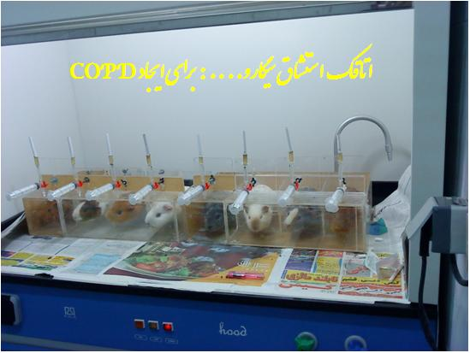
Asthma and COPD Smoking Room for Developing COPD

Slide 5
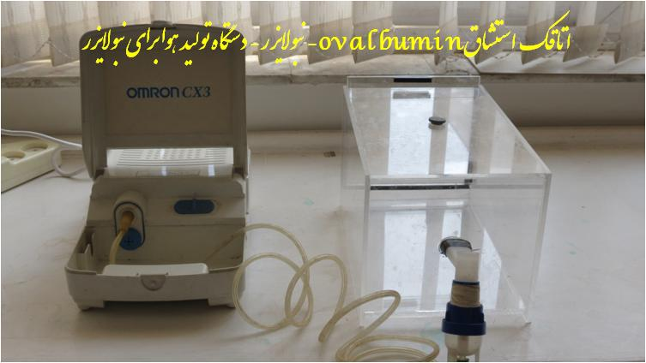
Asthma and COPD Ovalbumin Inhalation Room- Nebulizer, Air Generator Device for Nebulizer

Slide 6
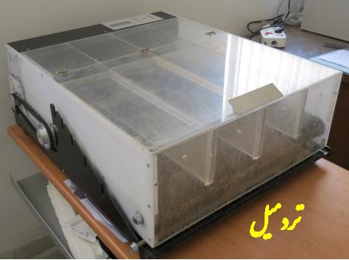
Studying the Effects of Exercise in Various Experimental Models on Animals (Rats and Mice) Treadmill

Slide 7
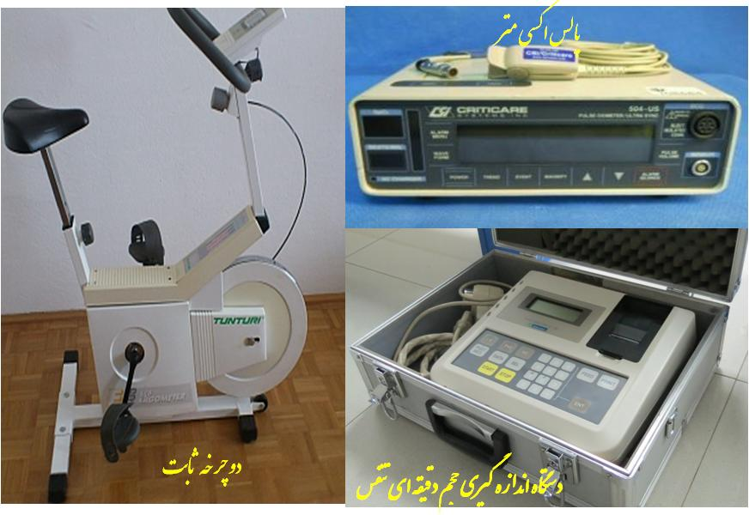
Studying the Effects of Exercise on Human Models Oximetry Pulse- Fixed Bicycle- Device to Measure Respiration Volume in Minutes

Slide 8
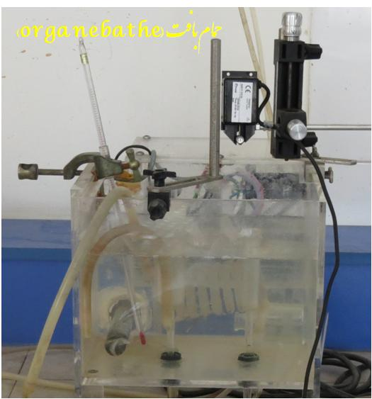
Distension Effects of Various Materials and Evaluation of Tracheal Response in Laboratory Animals Organ Bath

Slide 9
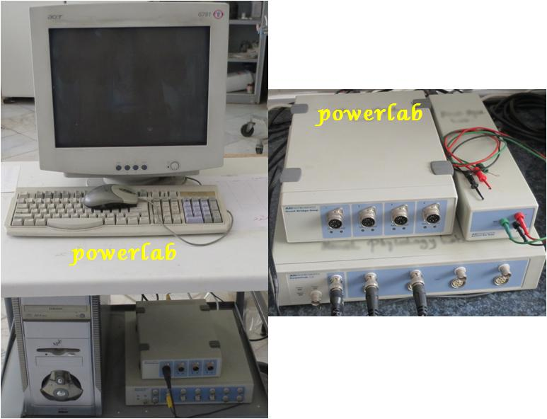
Distension Effects of Various Materials and Evaluation of Tracheal Response in Laboratory Animals PowerLab

Slide 10
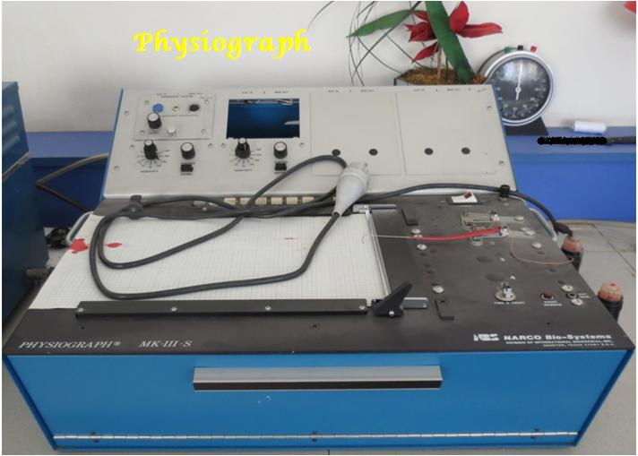
Distension Effects of Various Materials and Evaluation of Tracheal Response in Laboratory Animals Physiograph

Slide 11
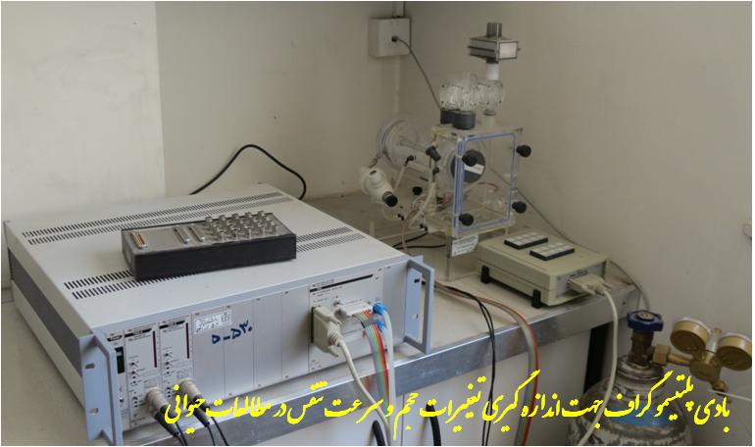
Effects of Various Factors on the Resistance of Respiratory Tract in Laboratory Animals In-vivo Body Plethysmograph to Measure the Changes in the Volume and Rate of Respiration in Animal Studies

Slide 12
General and Endocrinology Research Laboratory
Dr. Moosalreza Hajzadeh

Slide 13
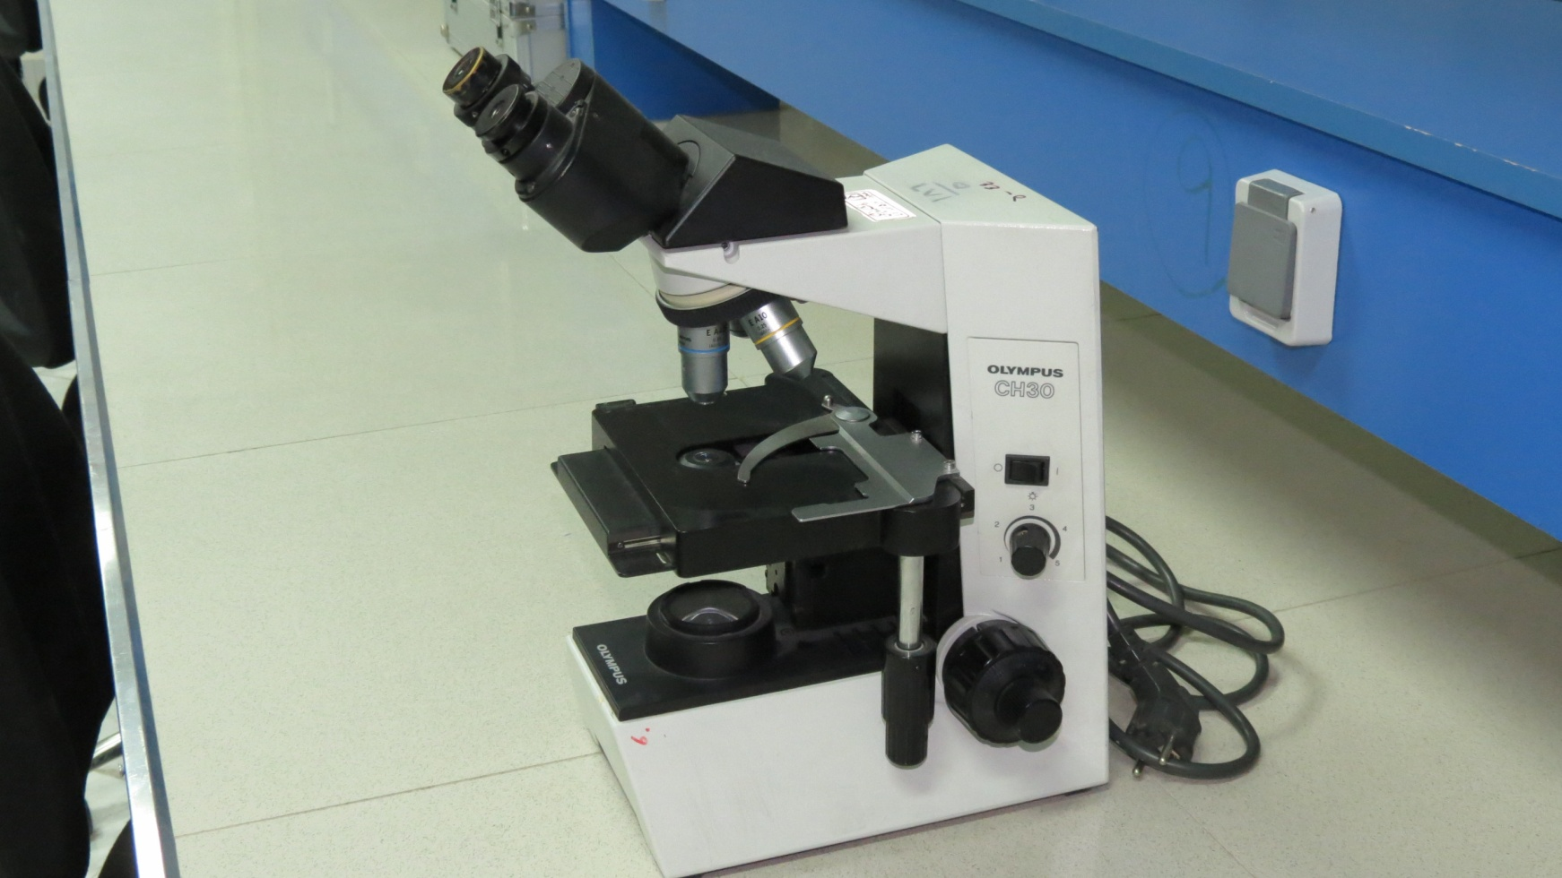
Microscope

Slide 14
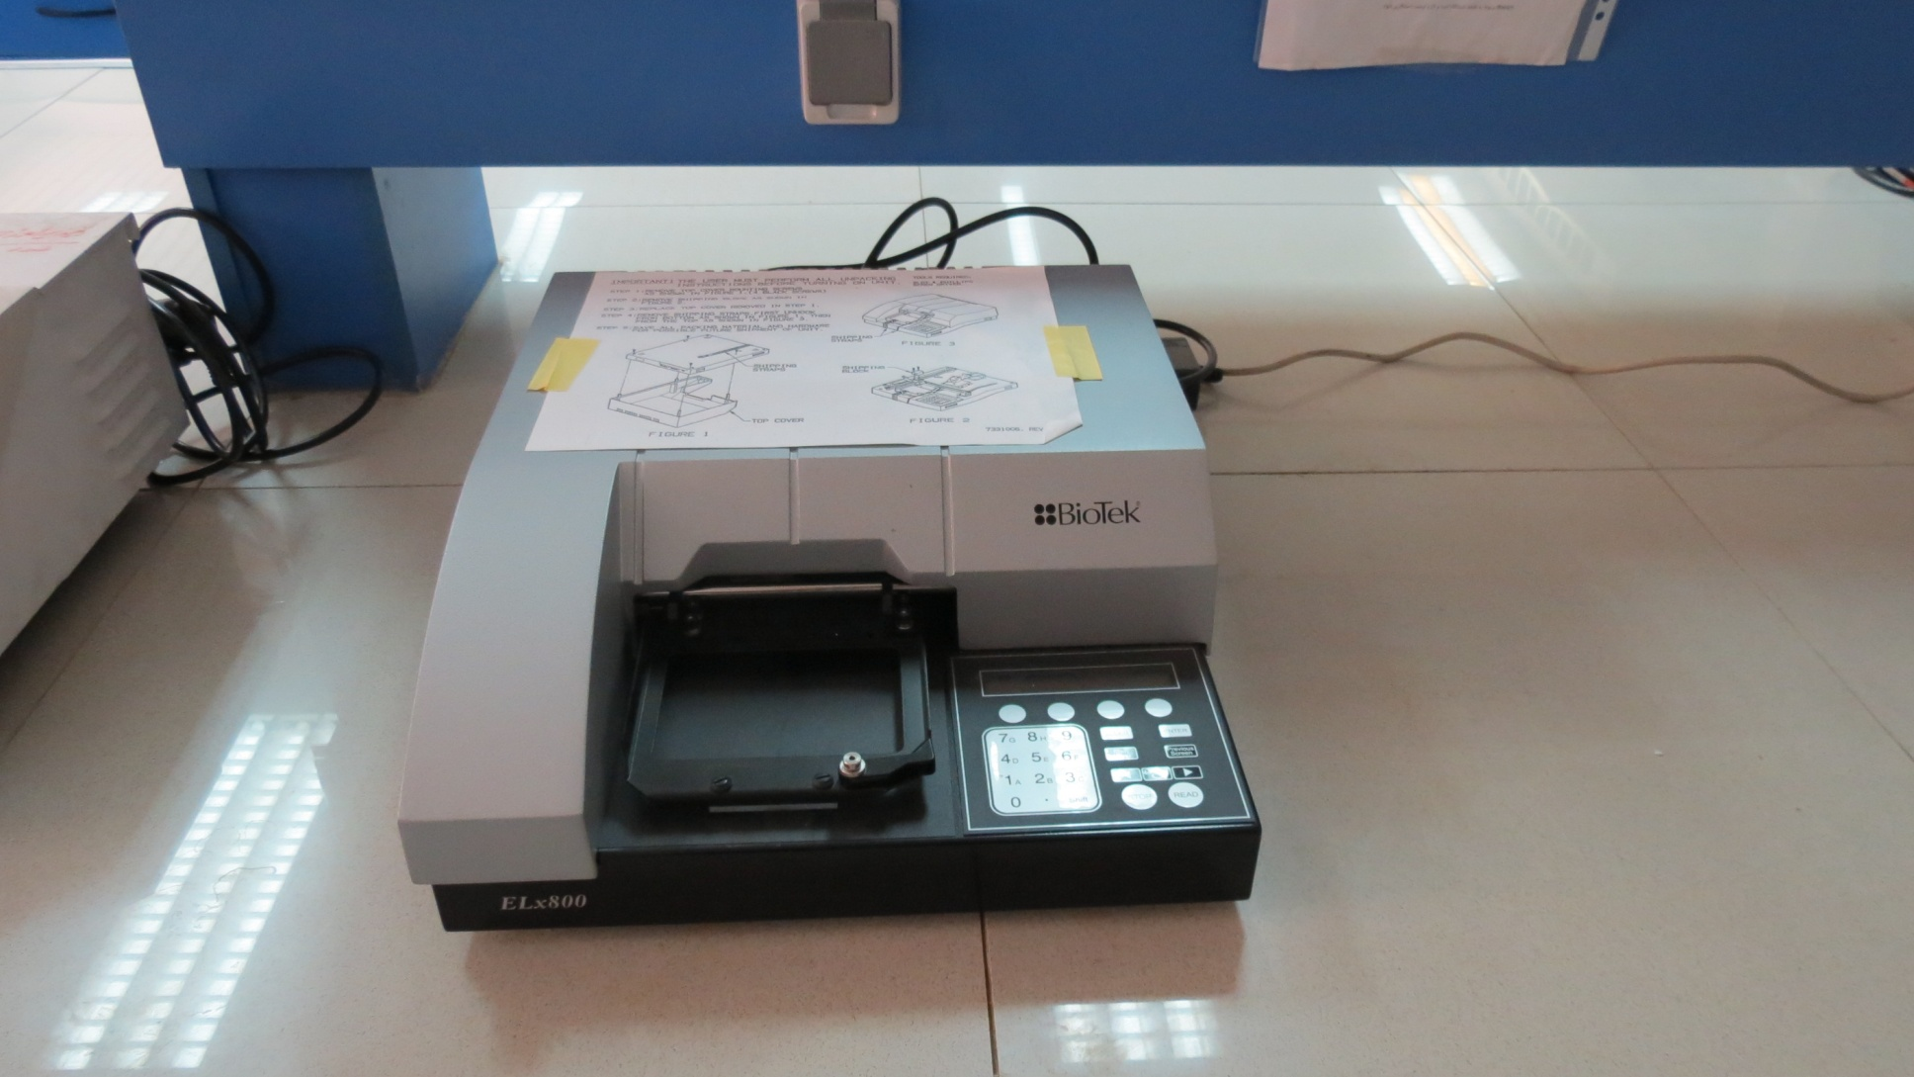
Elisa

Slide 15
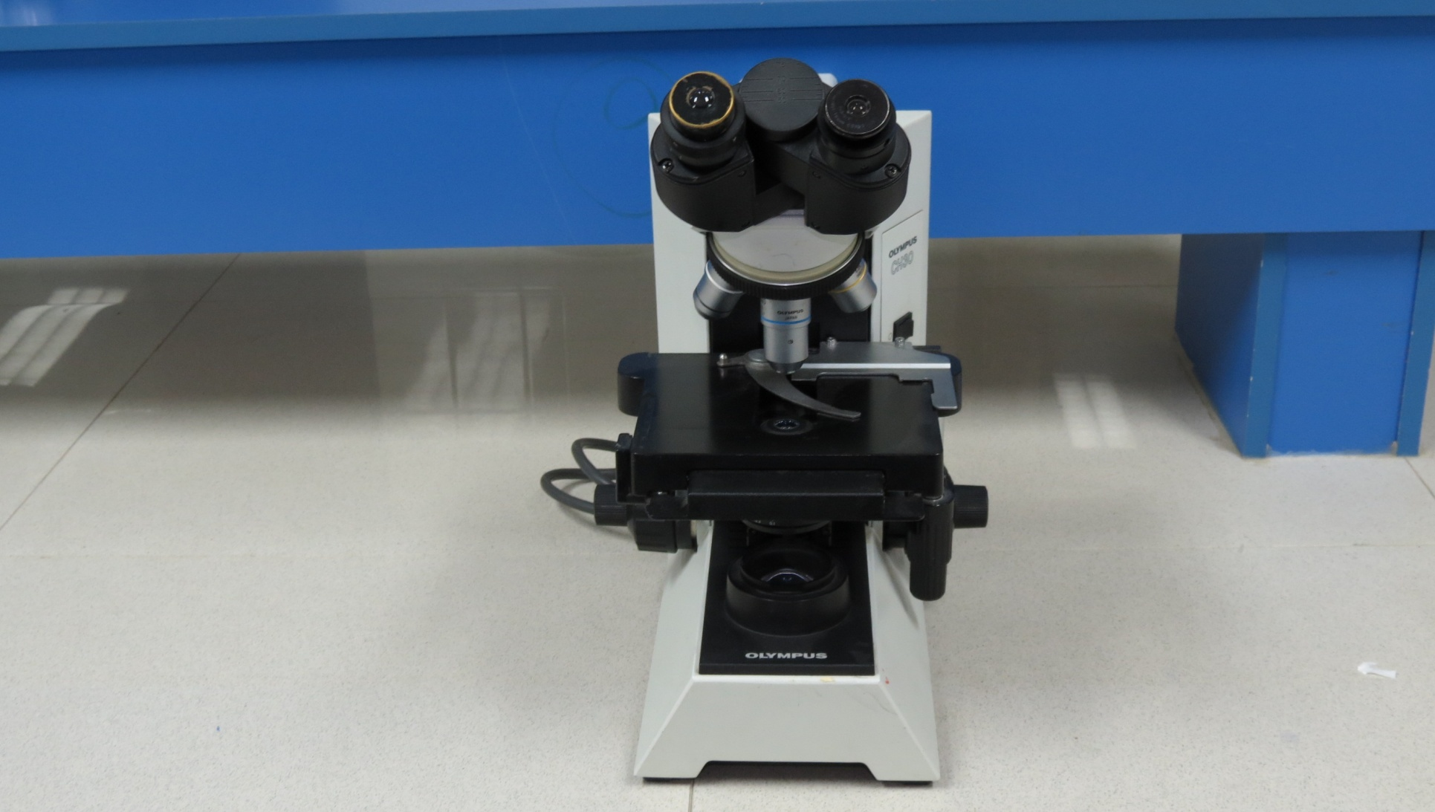
Optical Microscope

Slide 16
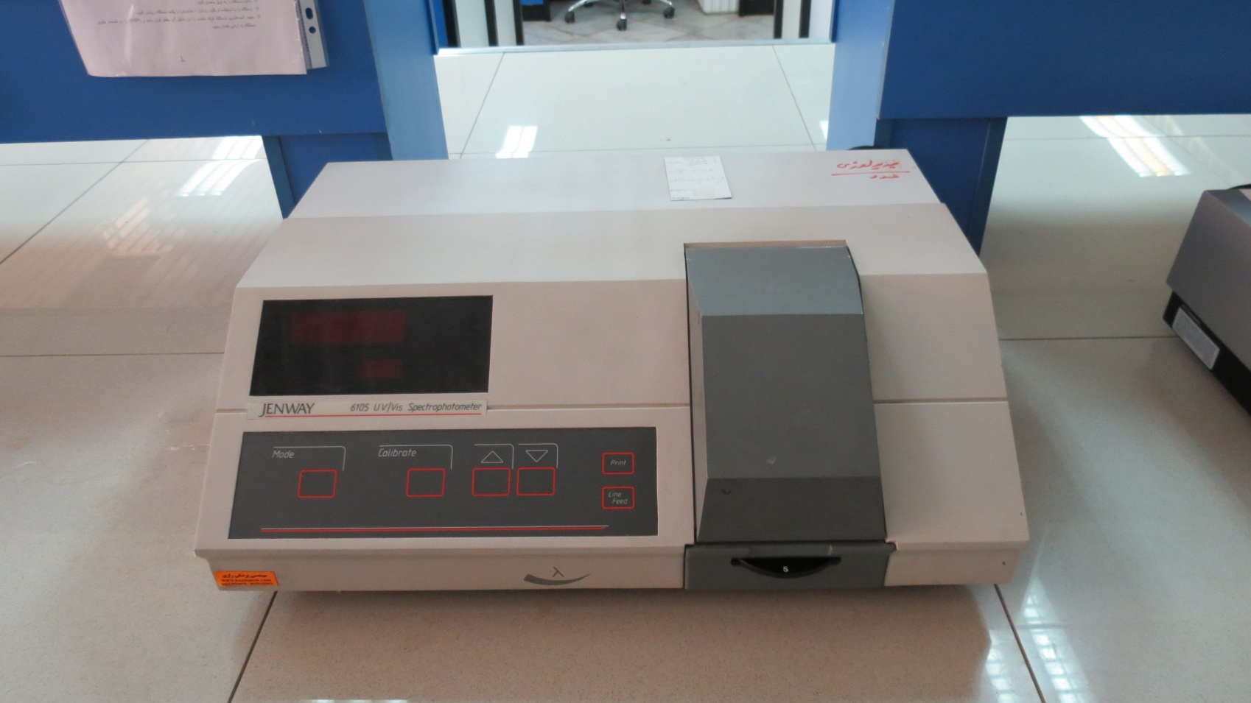
Spectrophotometer

