Slide 1
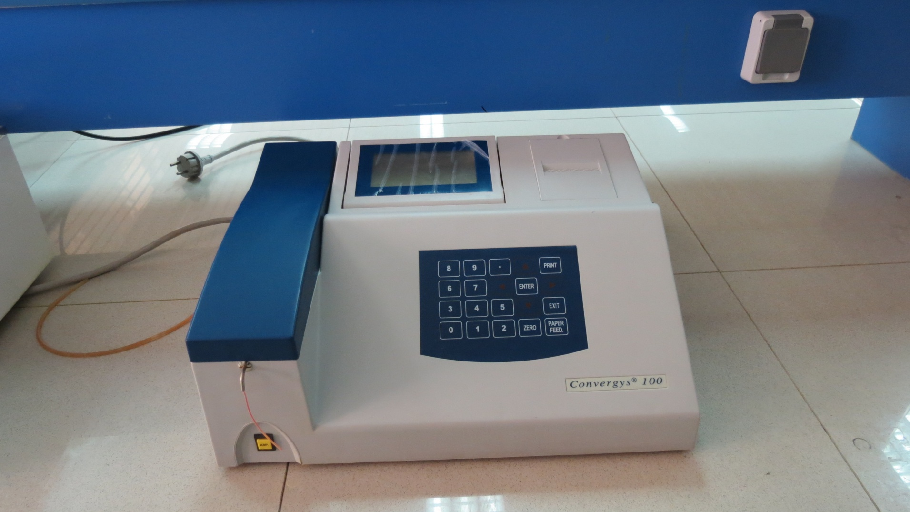
Photometer

Slide 2
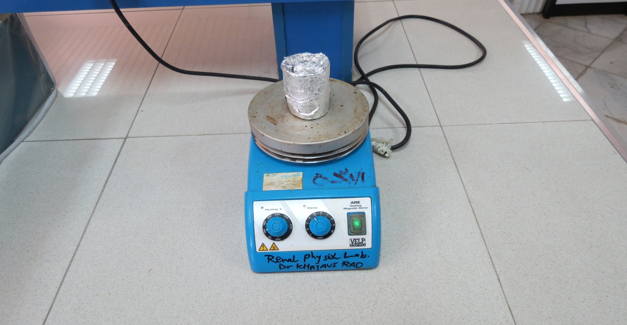
Vortex

Slide 3
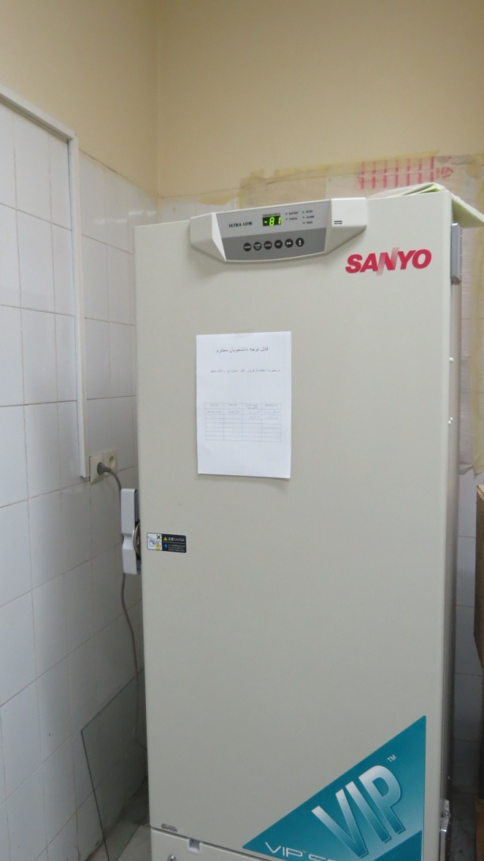
-80 Freezer

Slide 4
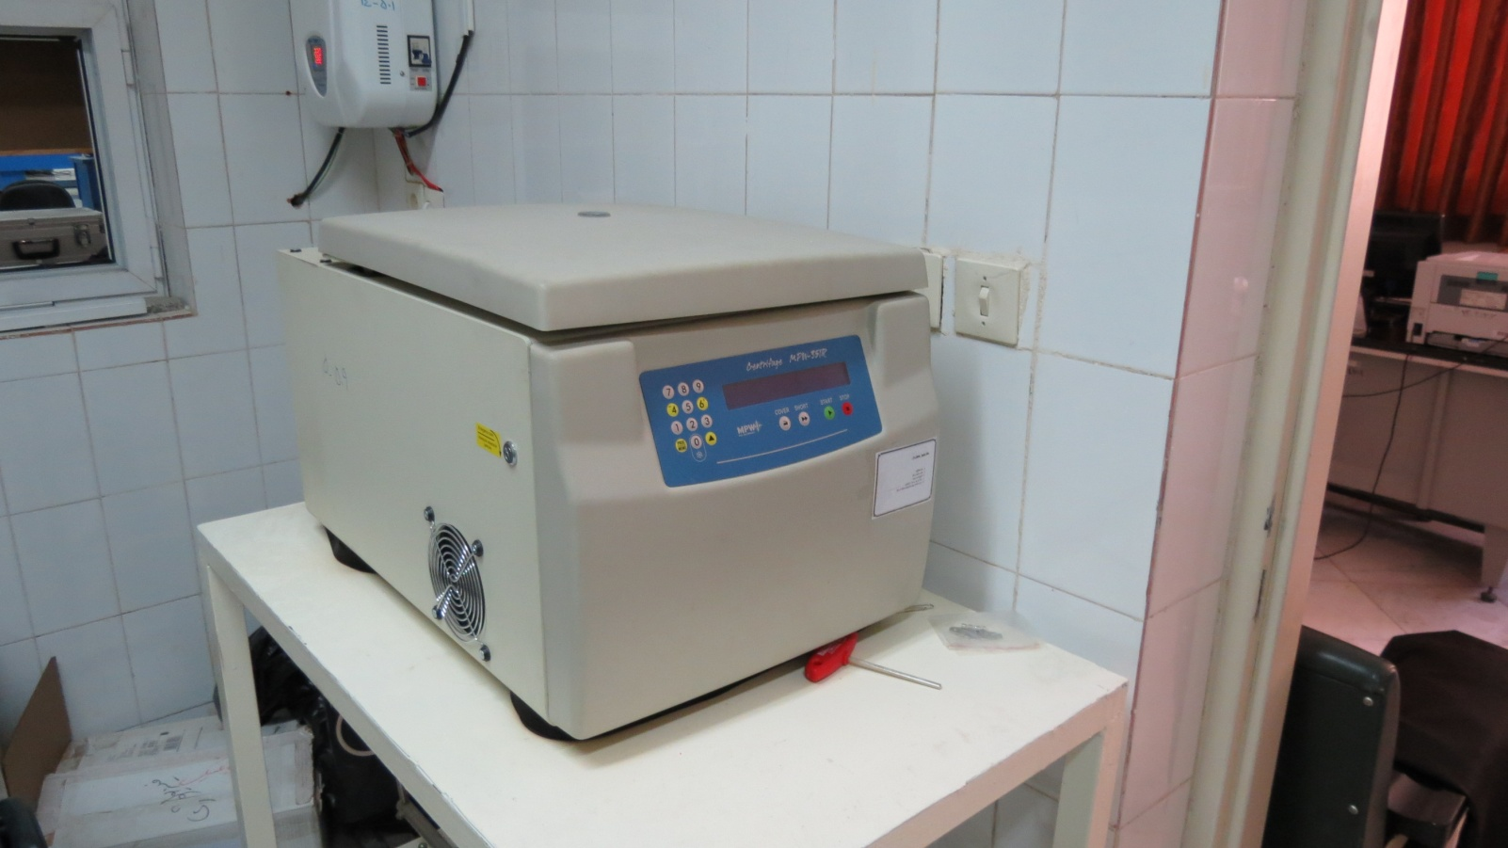
Rotary Refrigerator

Slide 5
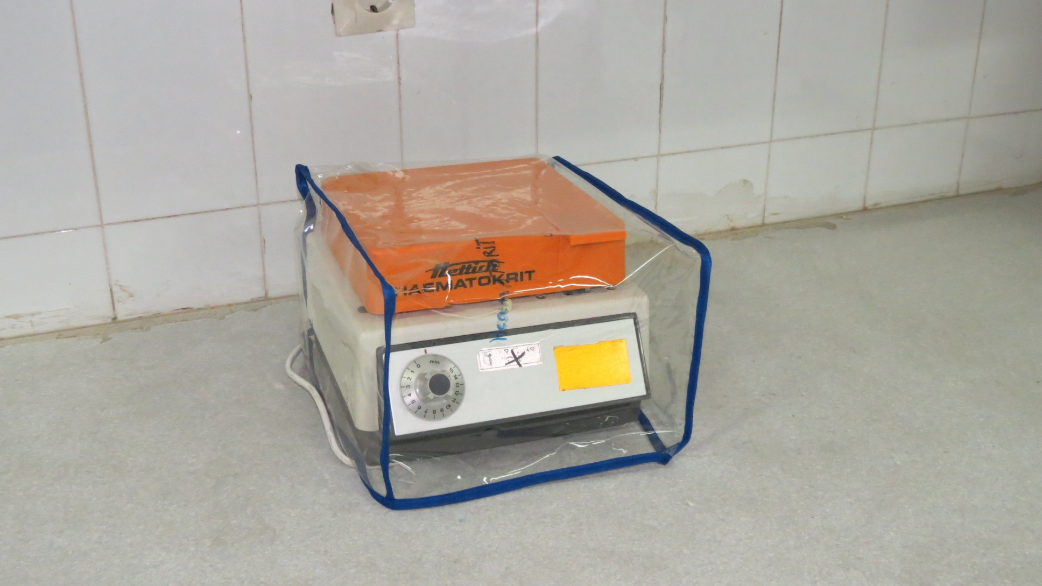
Microcentrifuge

Slide 6
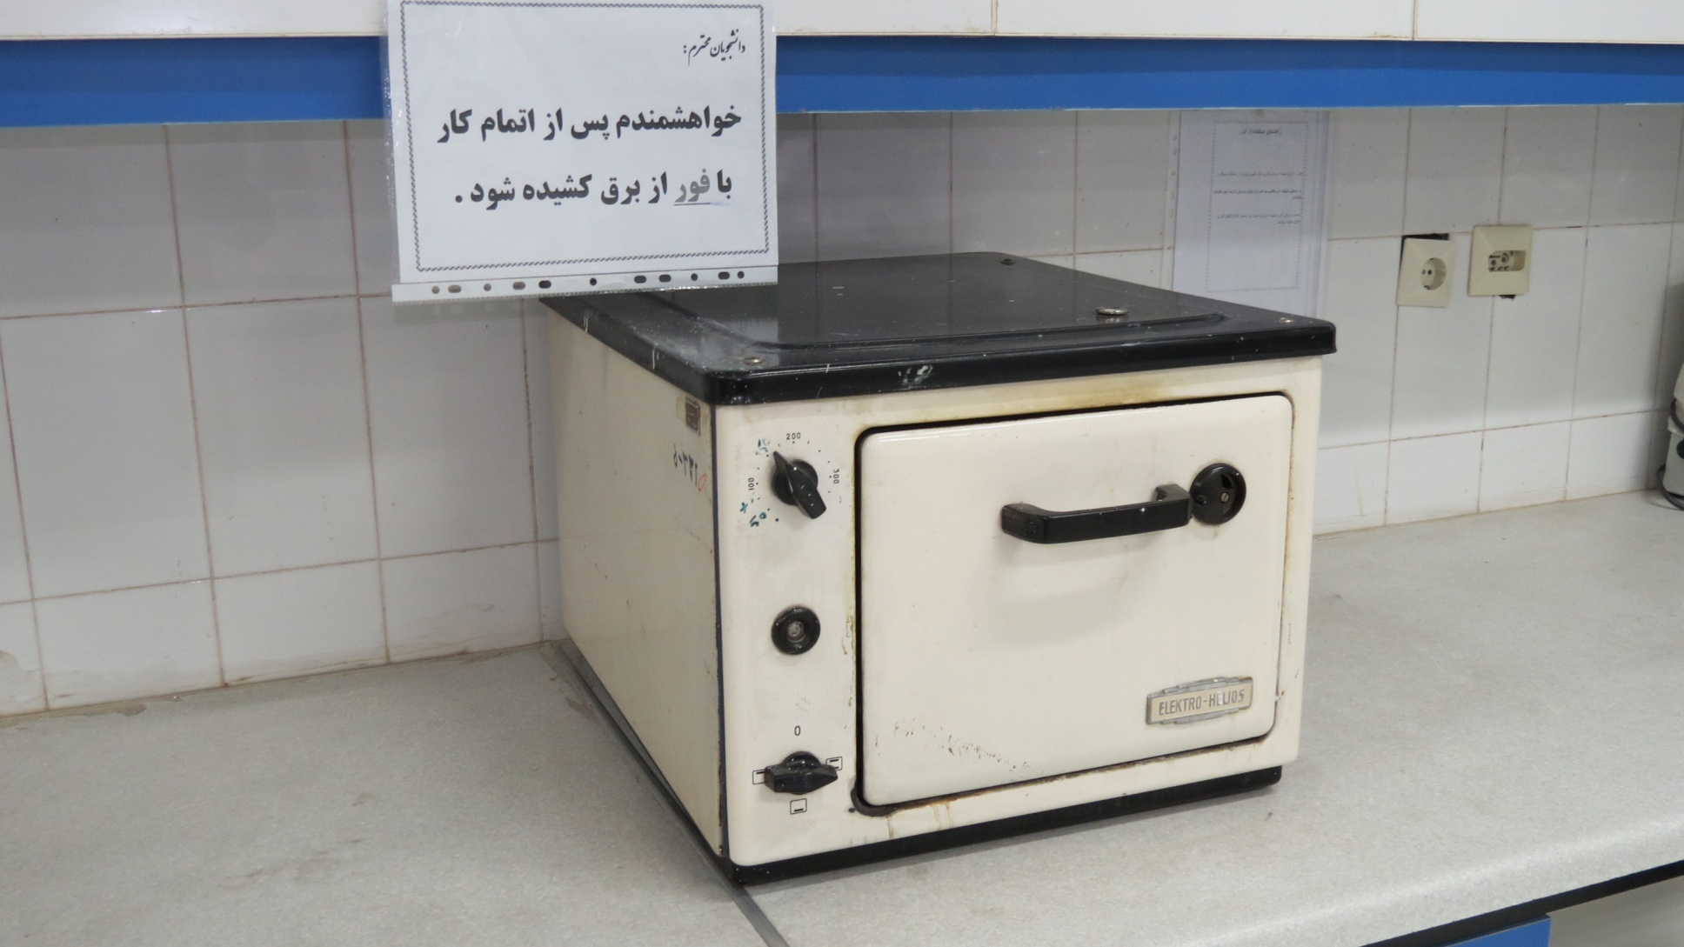
Laboratory Dry Heat

Slide 7
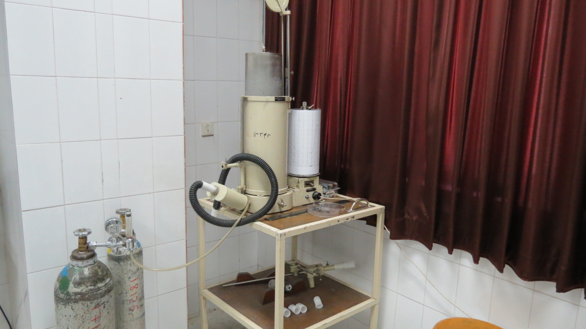
Aqua-spirometry

Slide 8
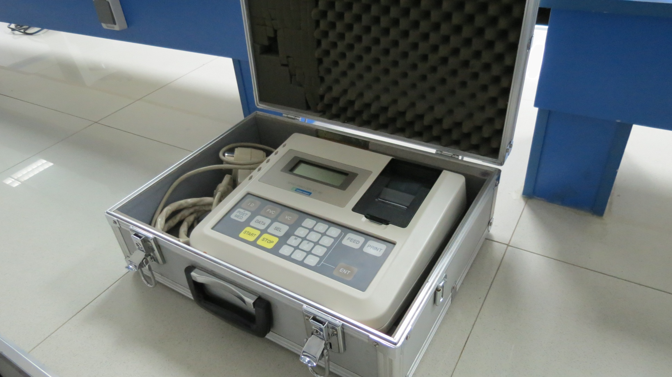
Digital Spirometry

Slide 9
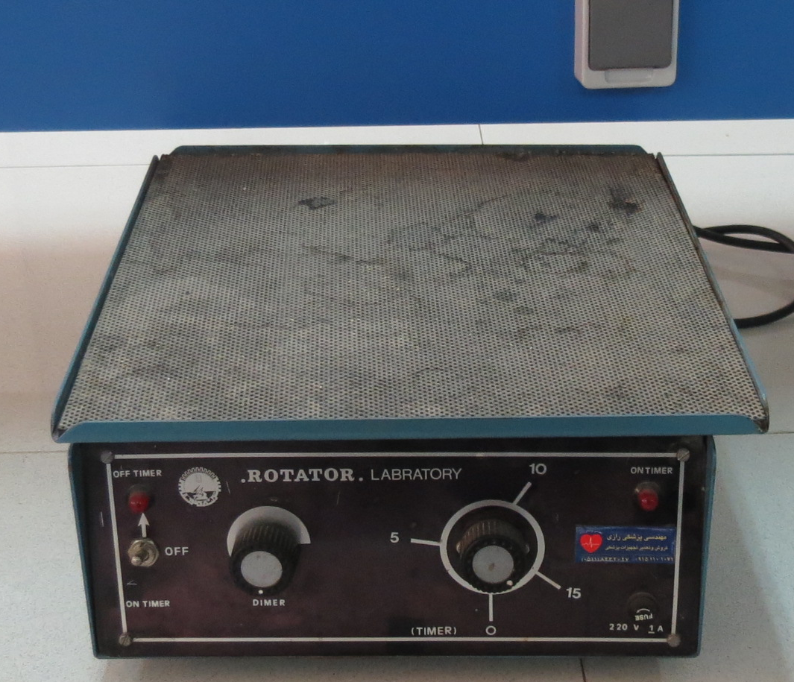
Rotator

Slide 10
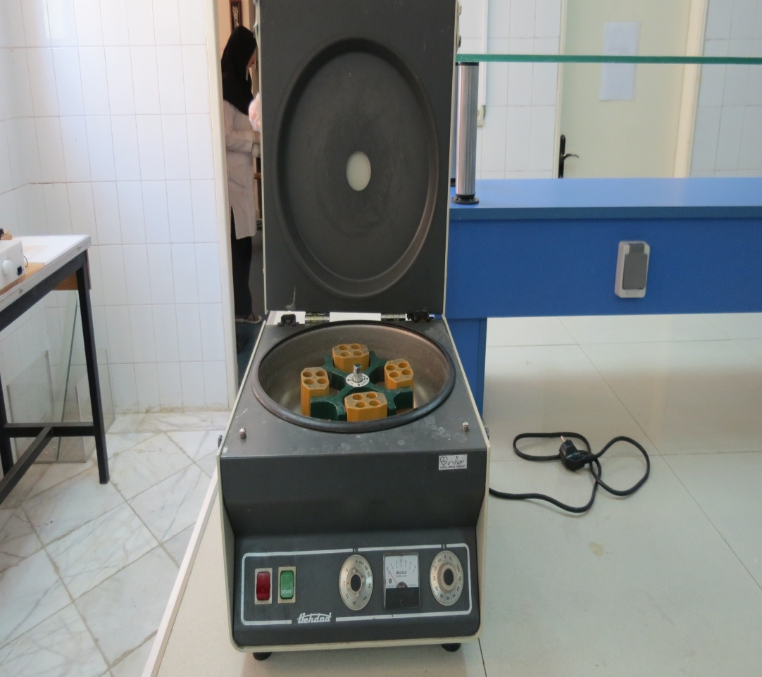
Centrifuge

Slide 11
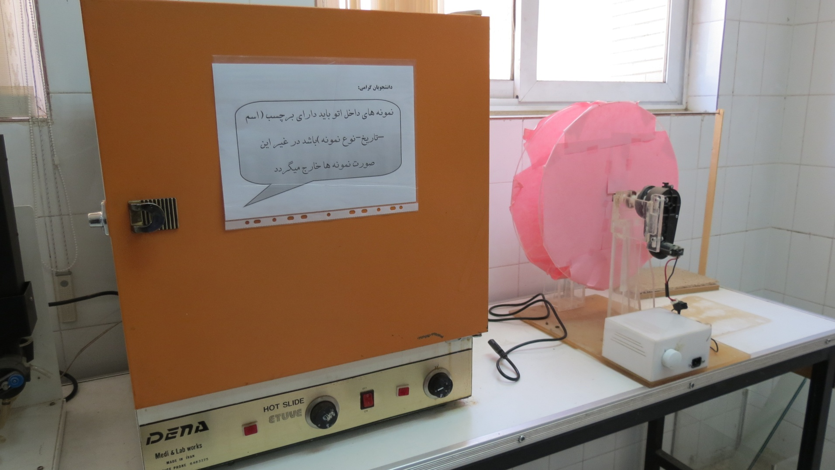
Iron

Slide 12
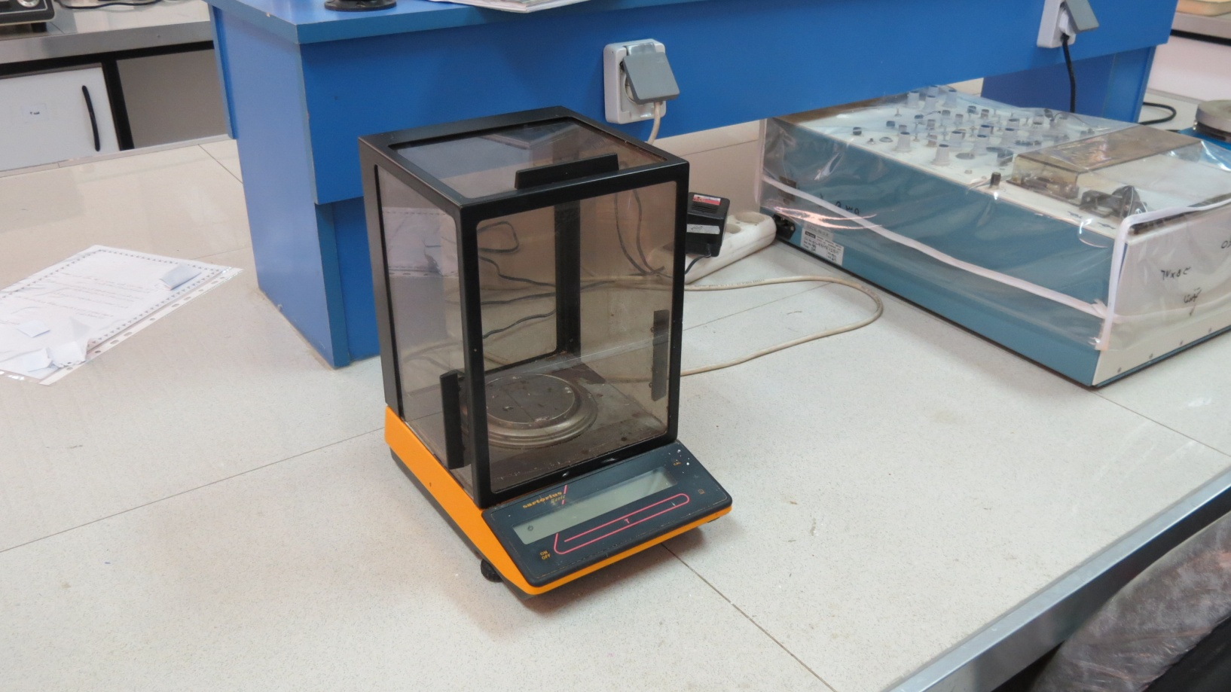
Sensitive Scale

Slide 13
Cardiovascular Research Laboratory
Dr. Saeid Niazmand
Dr. Maryam Mahmoudabadi

Slide 14
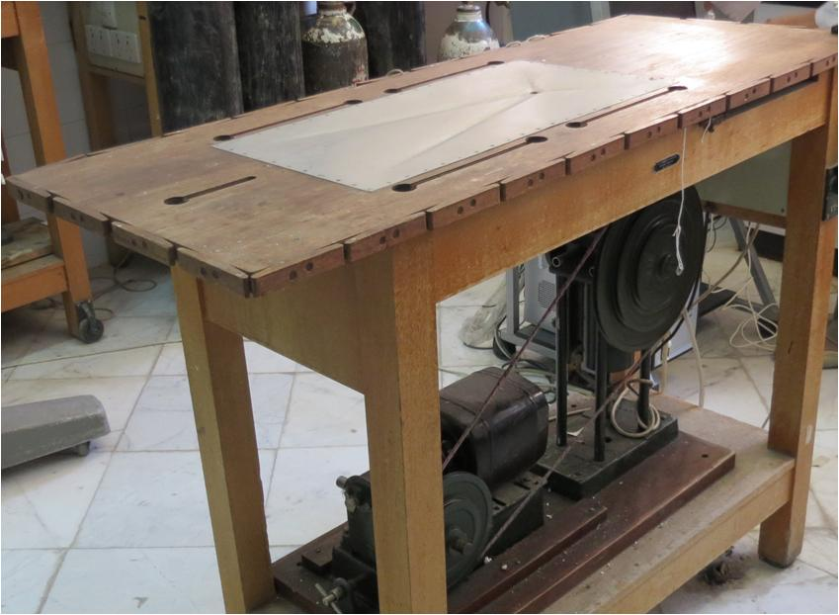
Animal Surgery Board

Slide 15
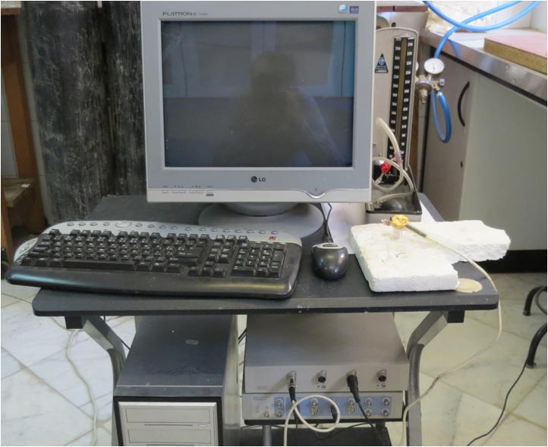
Powerlab

Slide 16
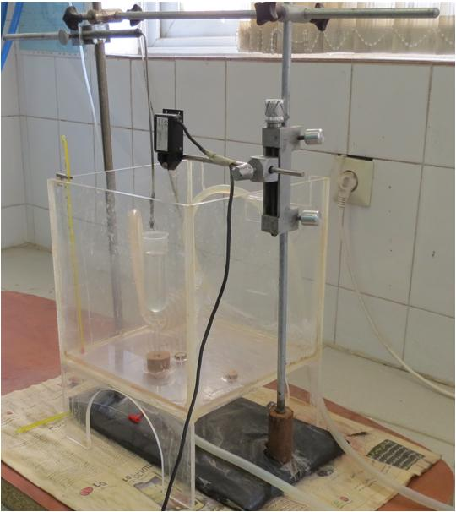
Organ Bath Specific for Aortic Records

Slide 17
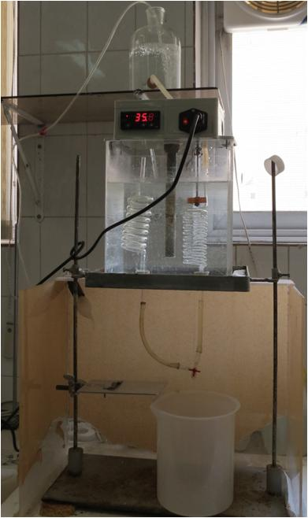
Isolated Cardiac Organ Bath

