Slide 1
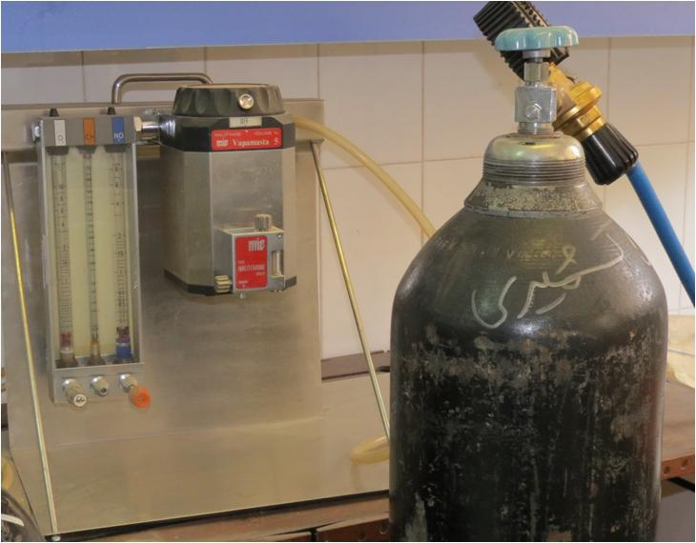
Co2 and O2 Gas Mixer

Slide 2
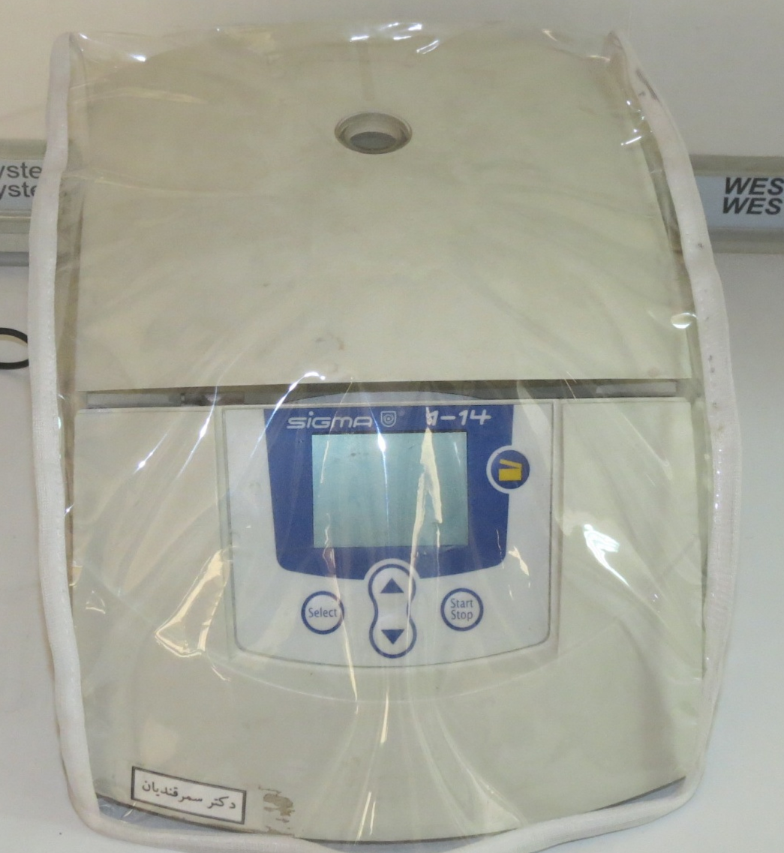
Microcentrifuge

Slide 3
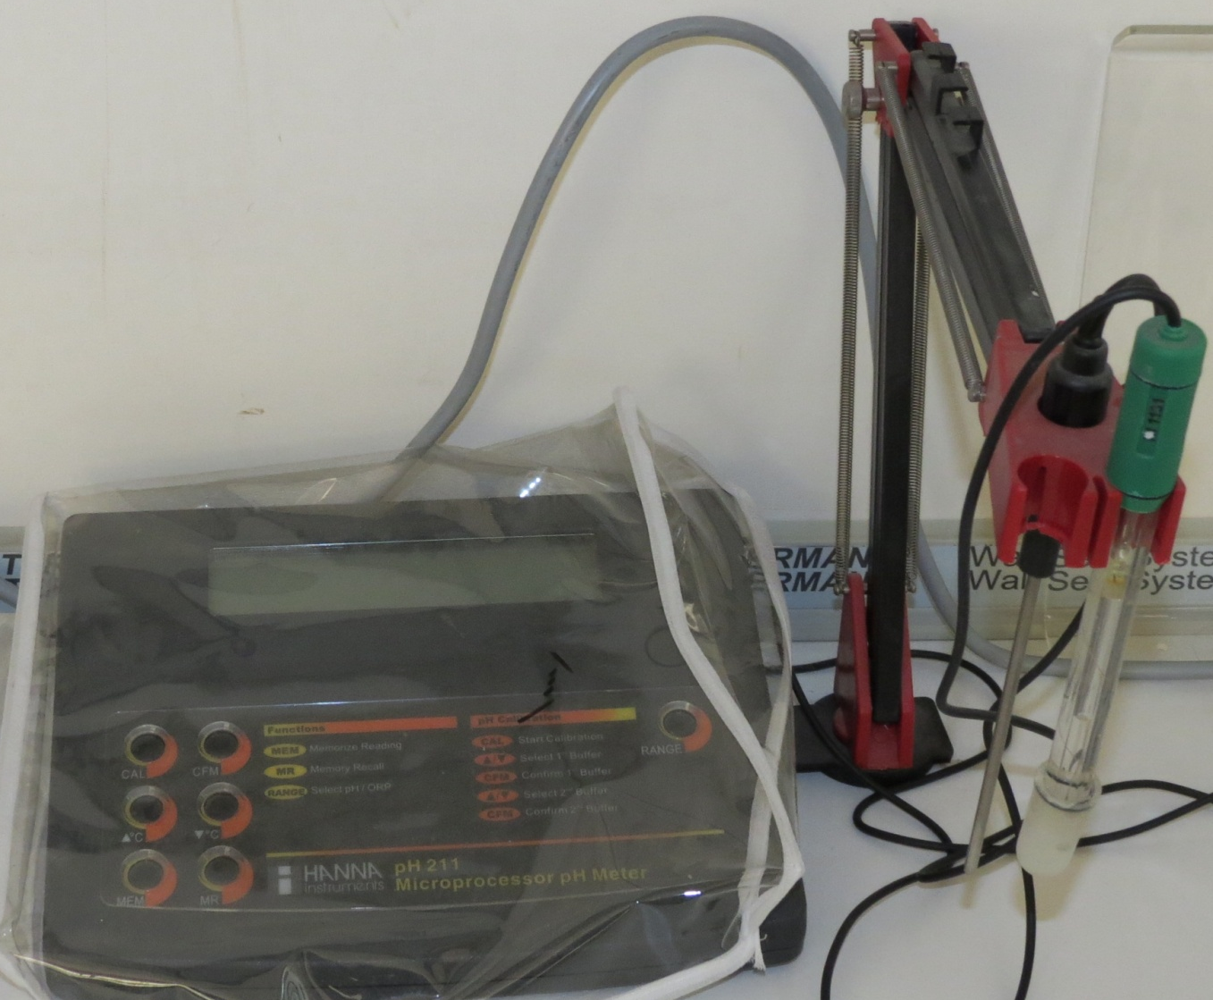
pH-meter

Slide 4
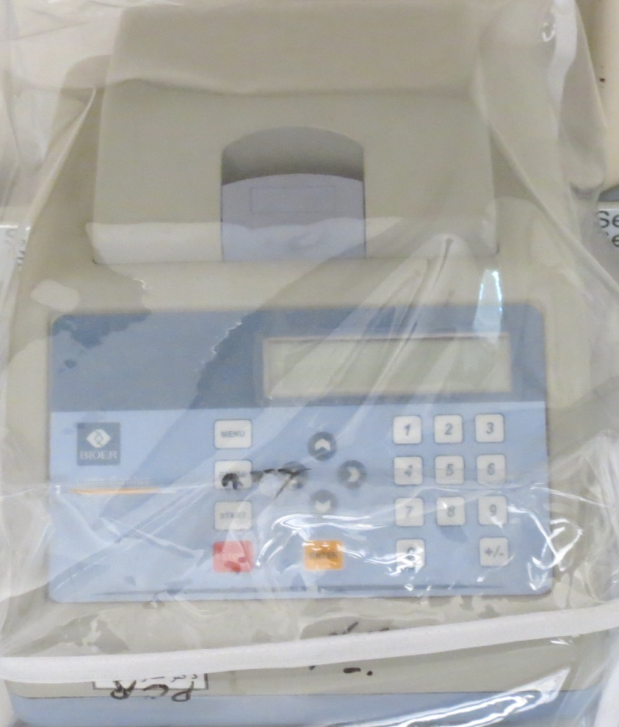
Thermal Cycler

Slide 5
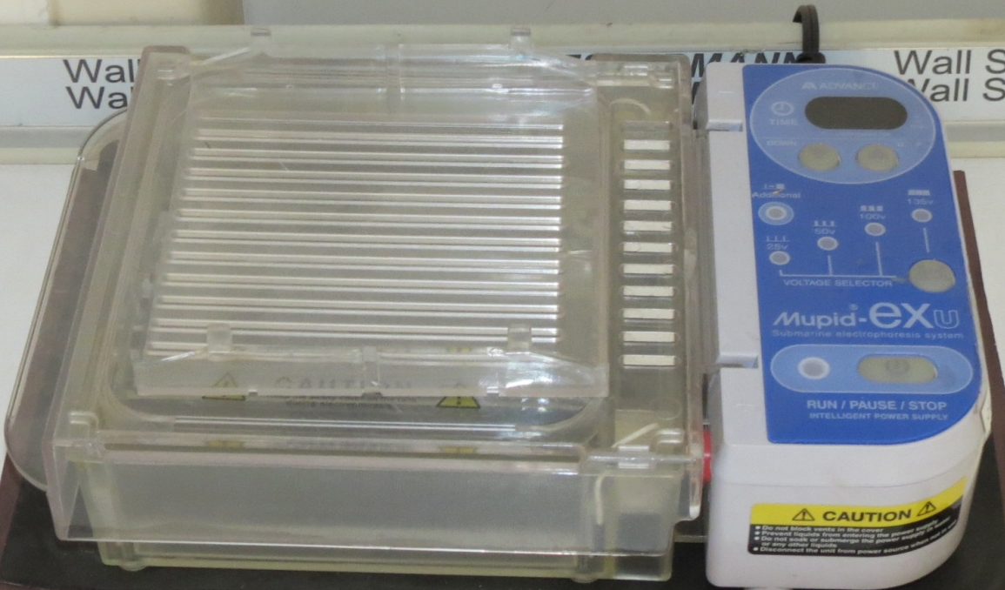
Electrophoresis Tank

Slide 6
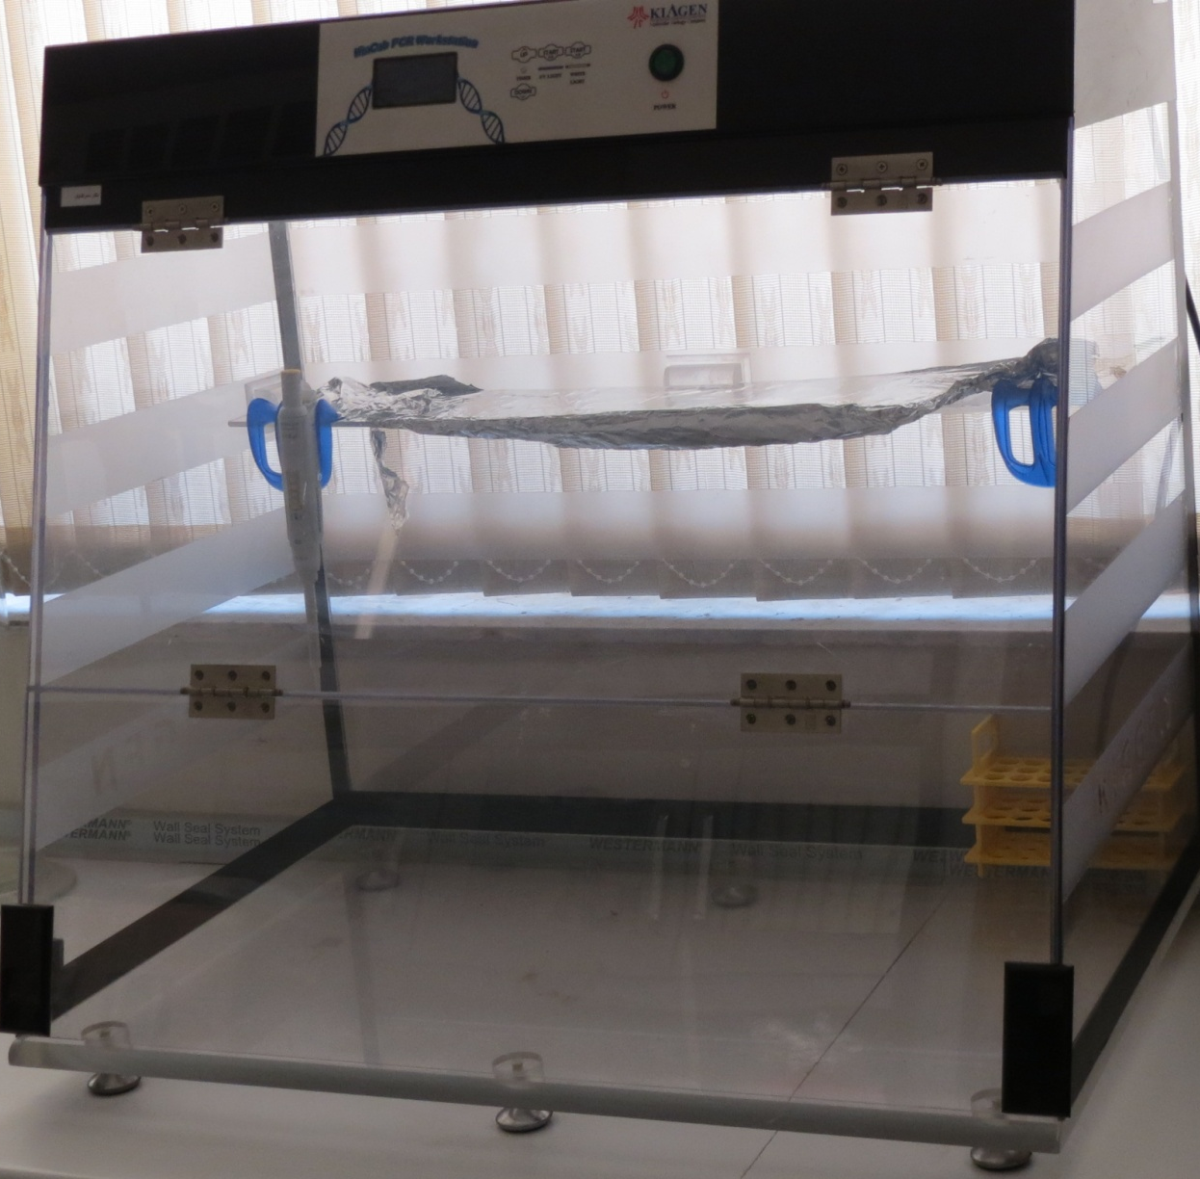
Hood

Slide 7
Kidney Research Laboratory
Dr. Abolfazl Khajavi Rad

Slide 8
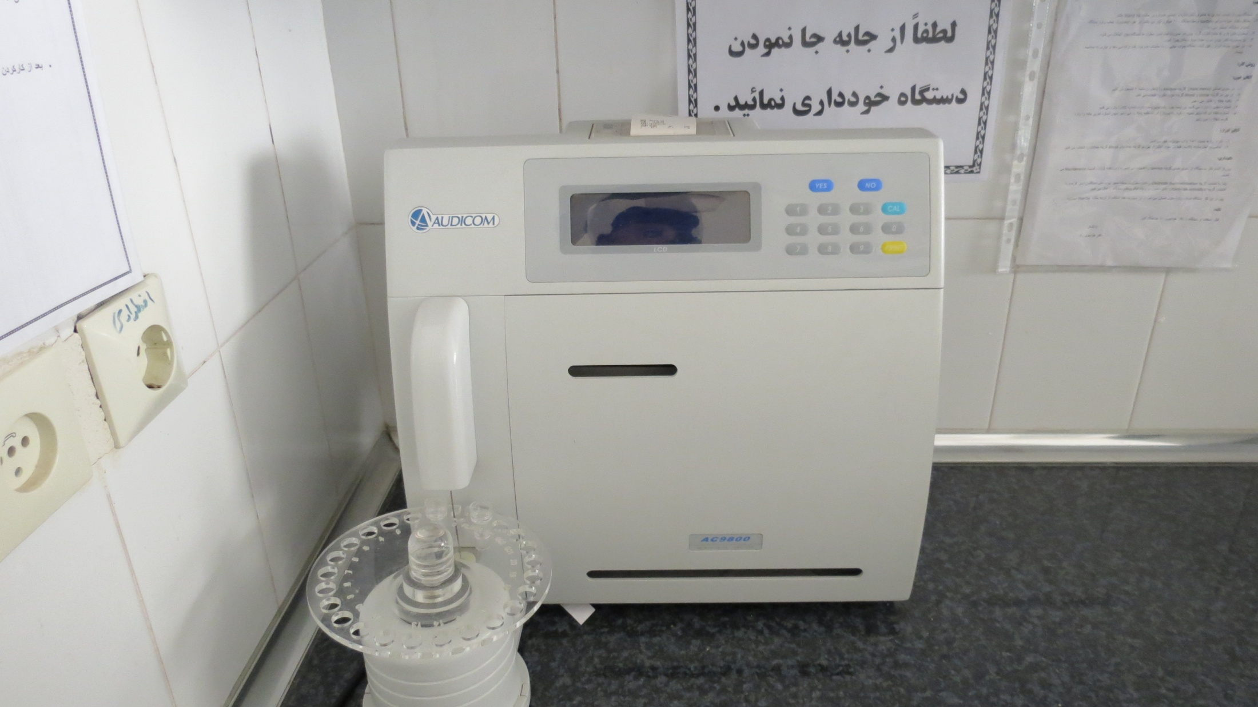
Electro-analyzer

Slide 9
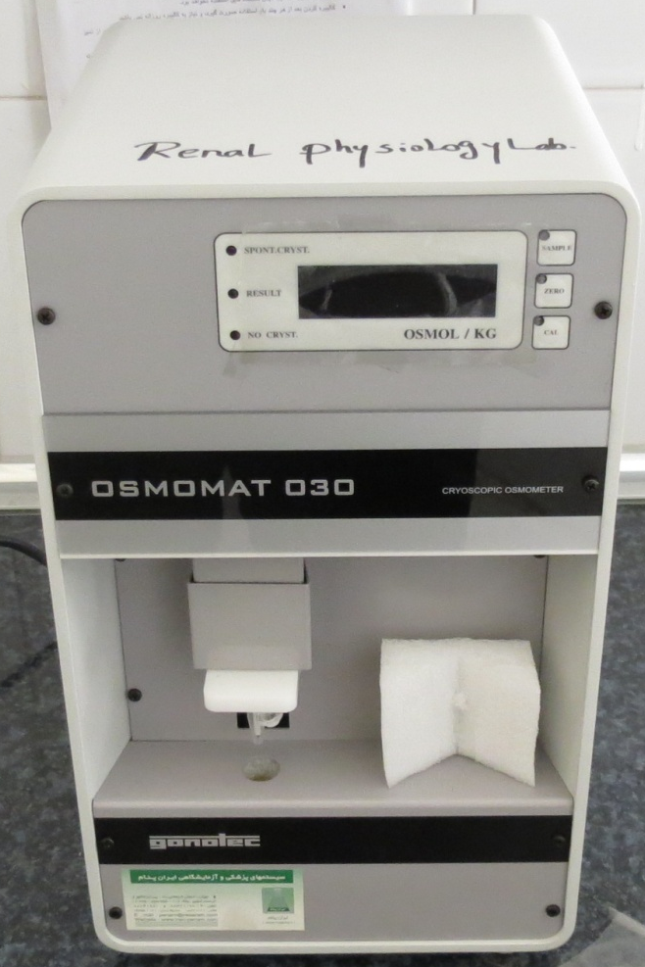
Osmometer

Slide 10
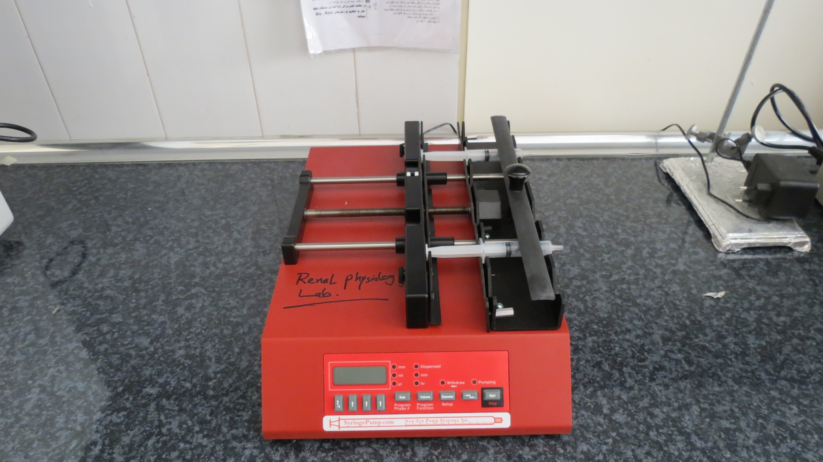
Syringe Pump

Slide 11
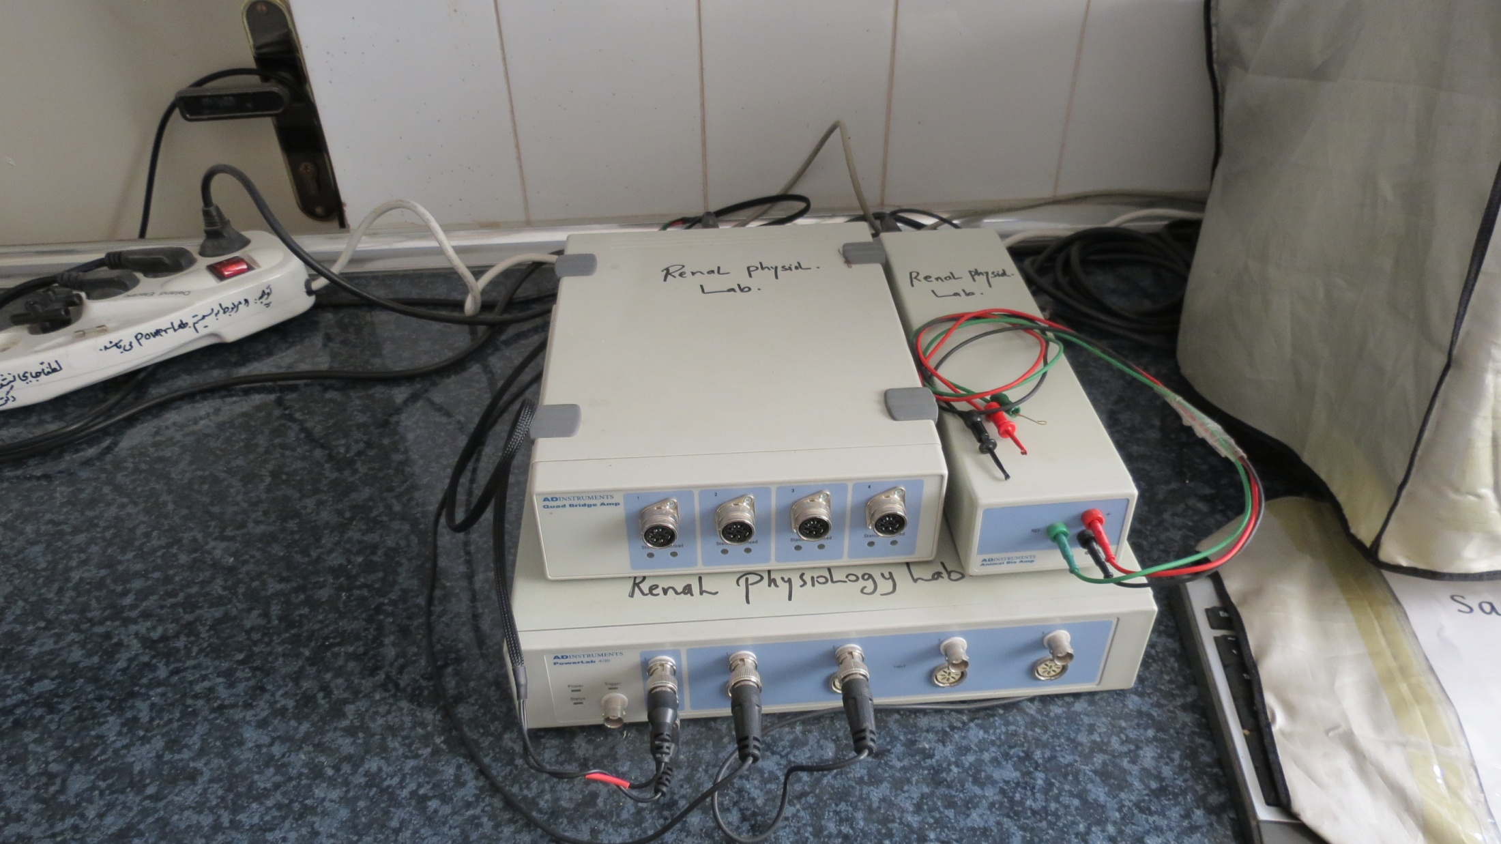
PowerLab

Slide 12
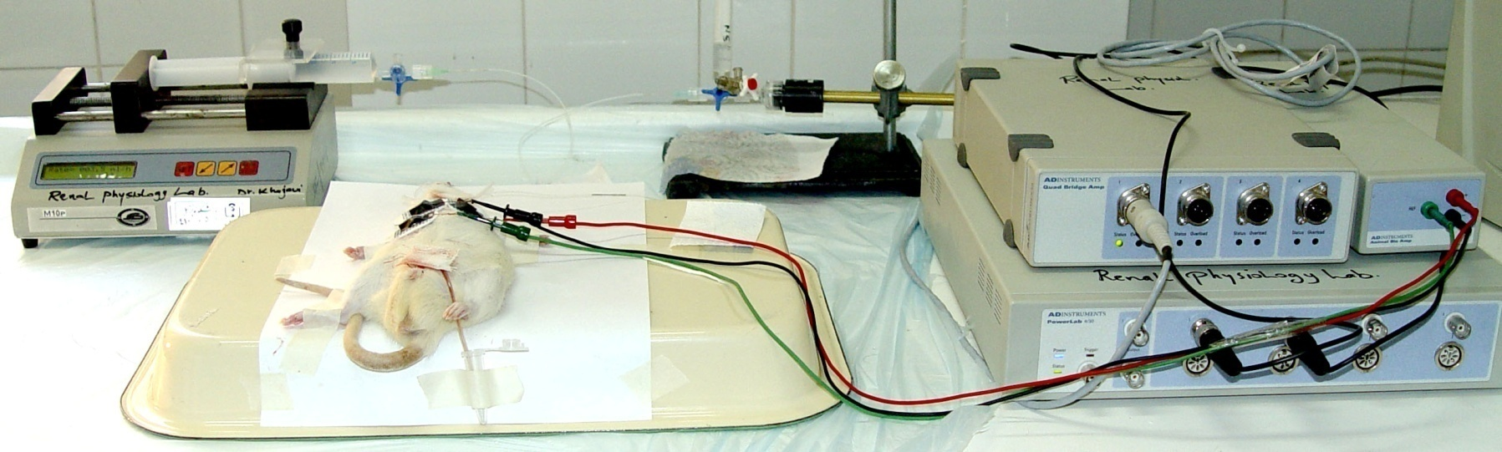
PowerLab Set-up

Slide 13
Neurosciences and Behavioral Studies Research Laboratory Dr. Seyed Mahmoud Hosseini, Dr. Mohammad Naser Shafei

Slide 14
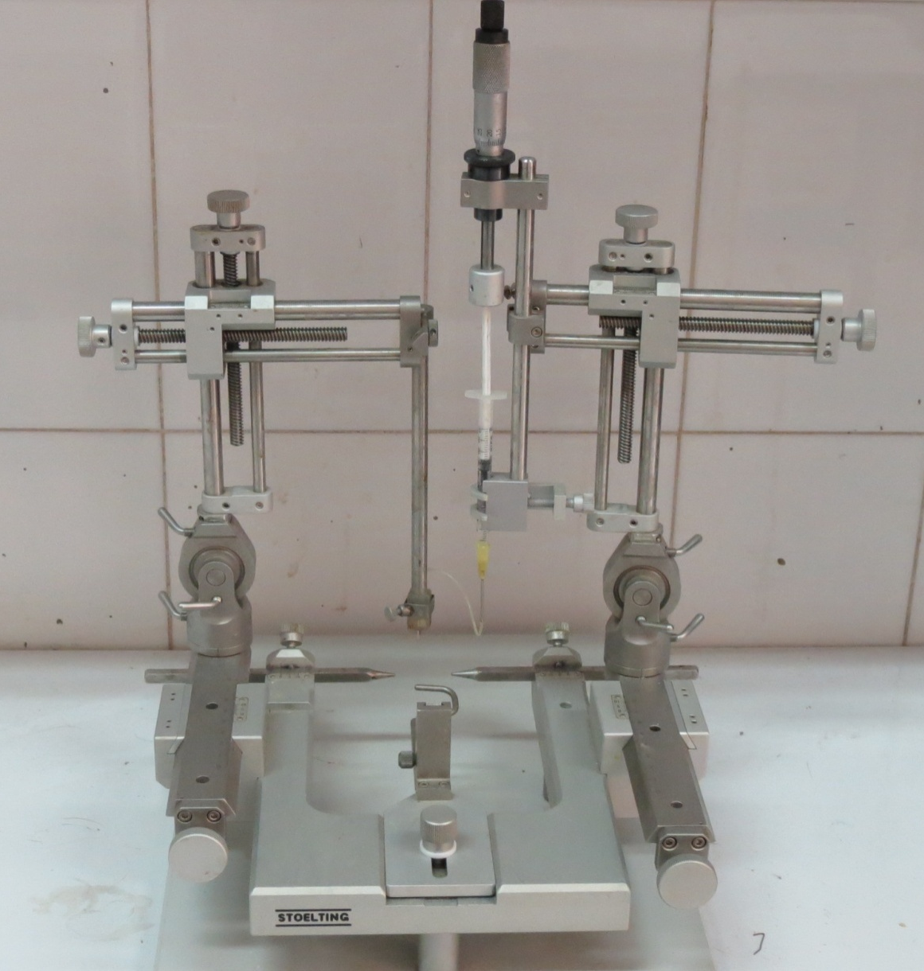
Stereotaxy

Slide 15
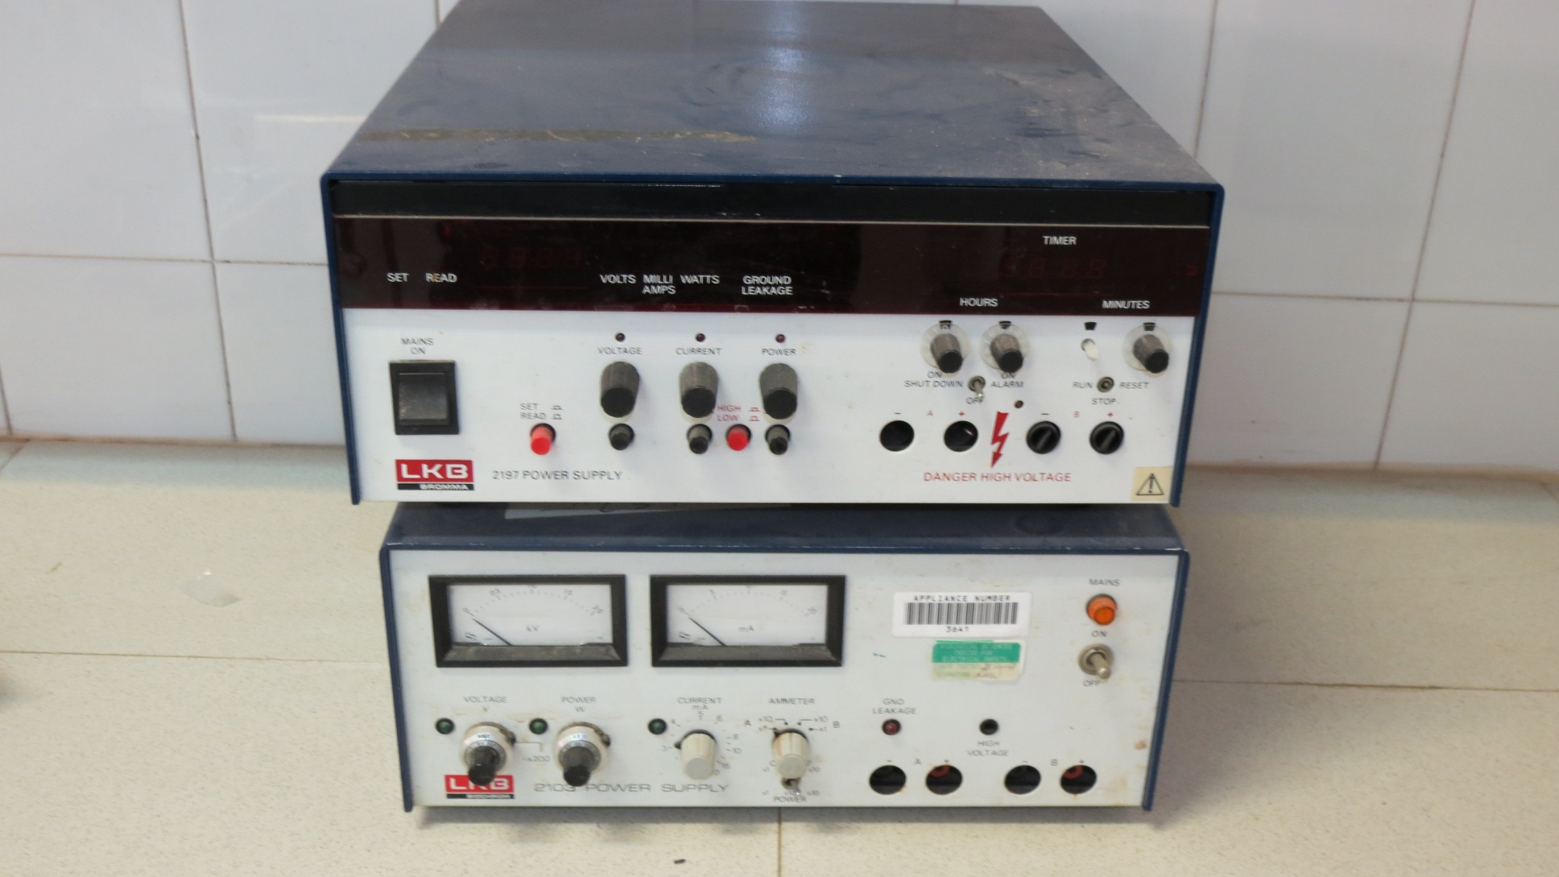
Stimulator

Slide 16
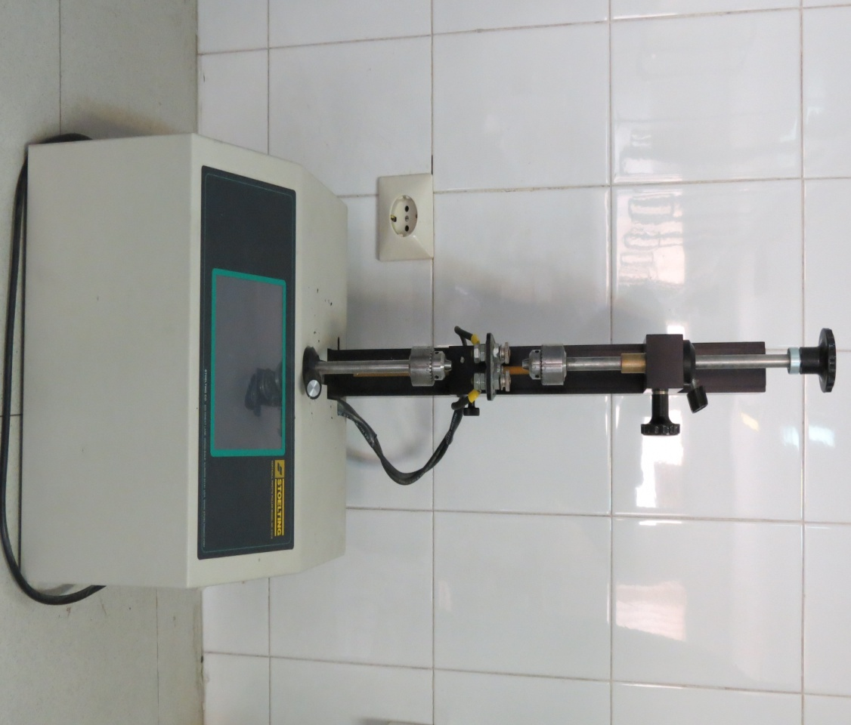
Pipette Puller

Slide 17
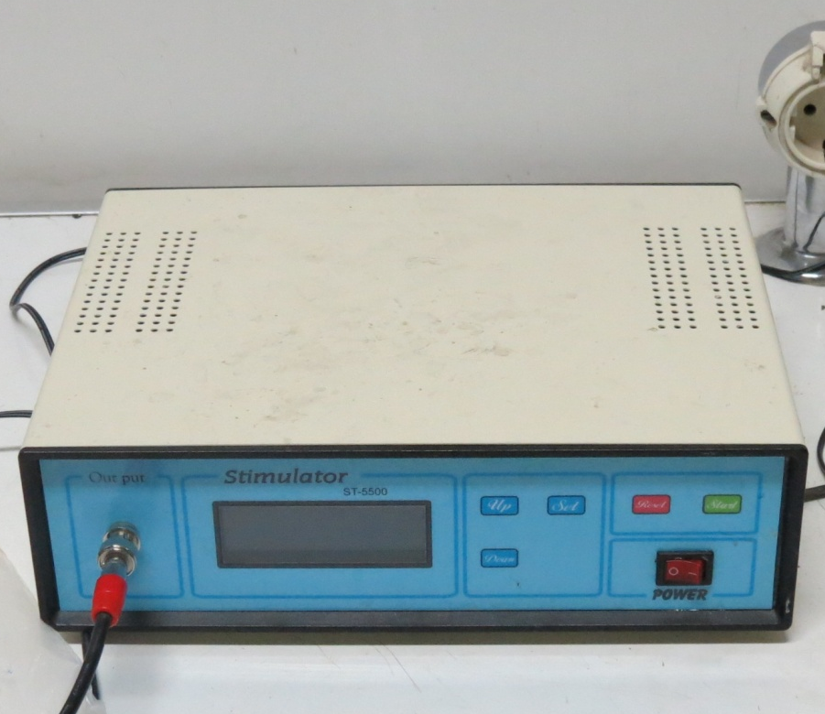
Stimulator

