Slide 1
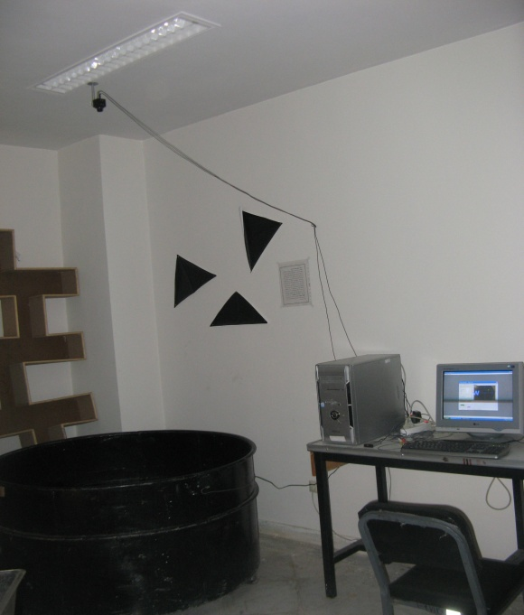
Water Maze Device and Accessories

Slide 2
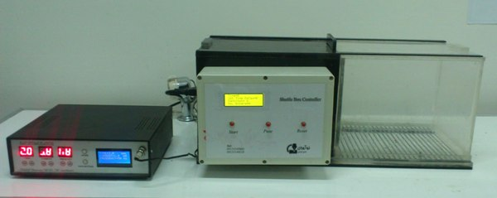
Non-active Avoidance Learning Maze and Stimulator

Slide 3
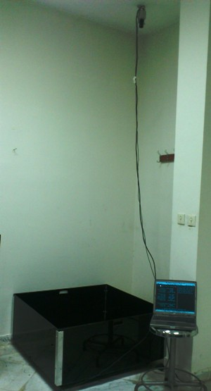
Open-box Device

Slide 4
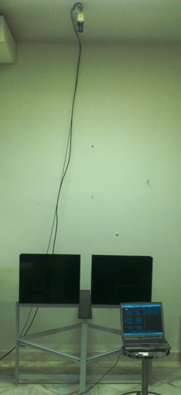
High Crusade Maze Device

Slide 5
Molecular Research Lab
Dr. Maryam Mahmoudabadi
دکتر مریم محمودآبادی

Slide 6
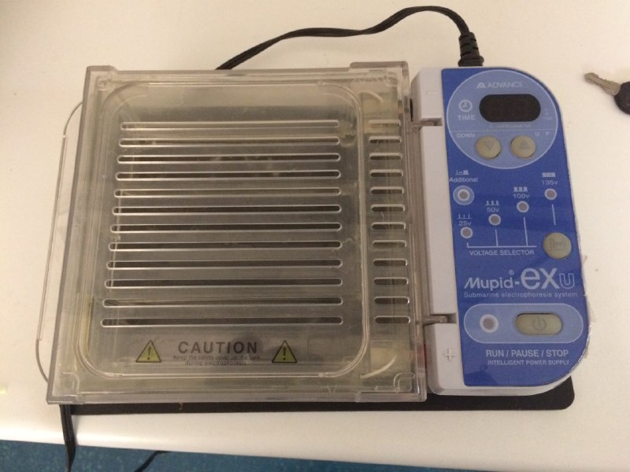
Electrophoresis

Slide 7
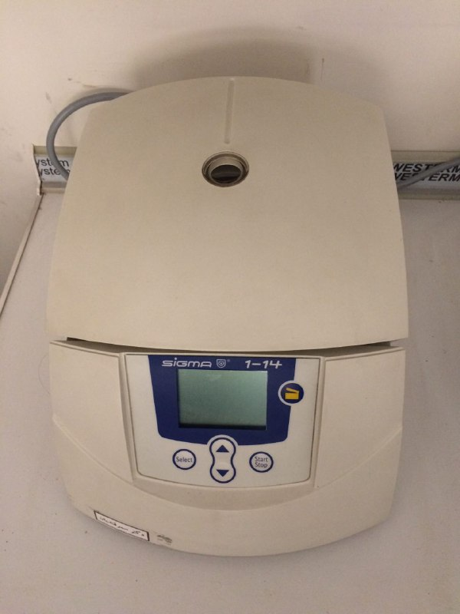
Centrifuge

Slide 8
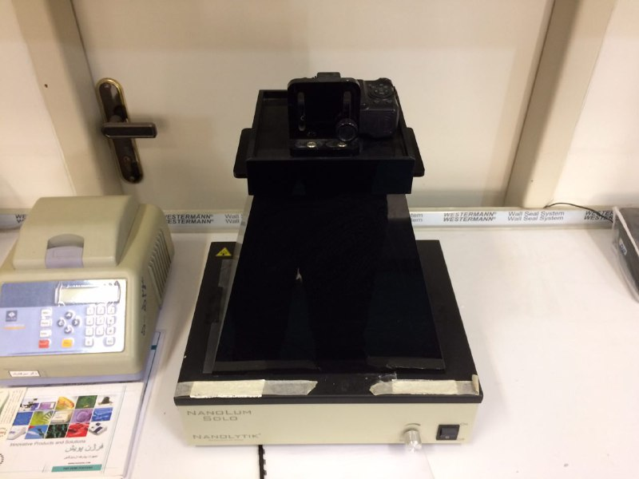
Gel Documentation system (Gel Doc)

Slide 9
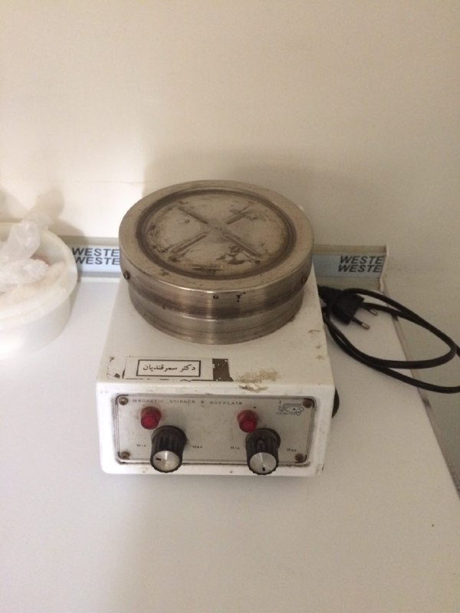
Magnetic heater stirrer

Slide 10
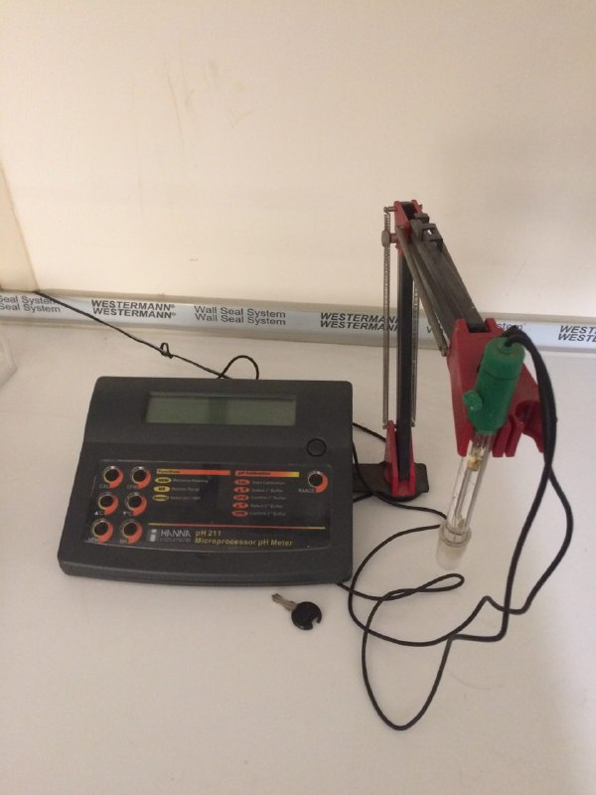
PH Meter

Slide 11
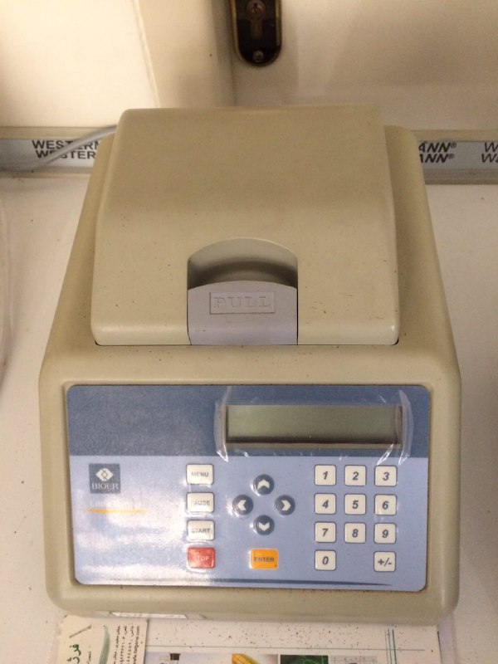
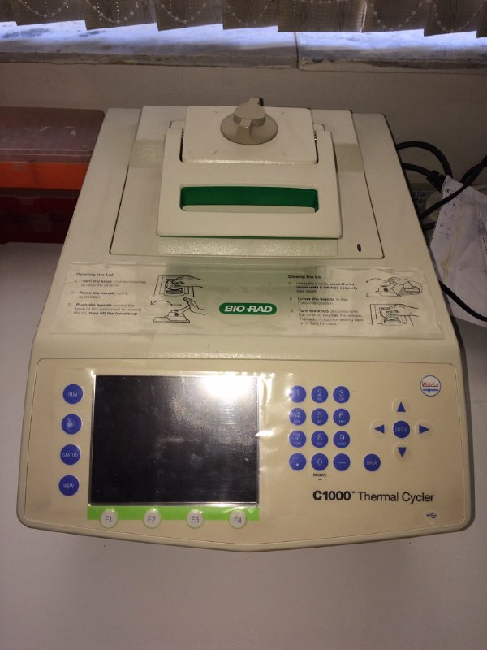
Thermocycler

Slide 12
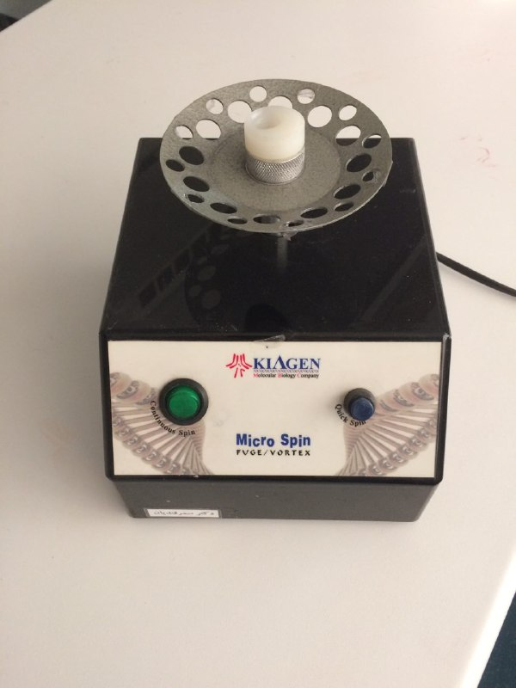
vortex

Slide 13
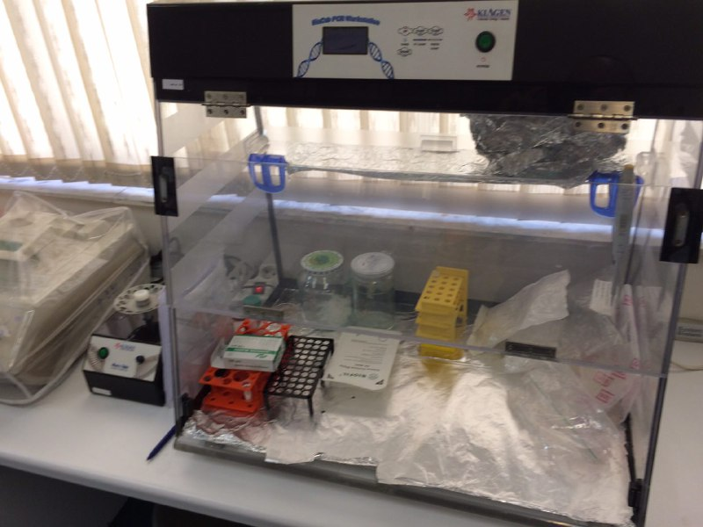
PCR Work station

Slide 14
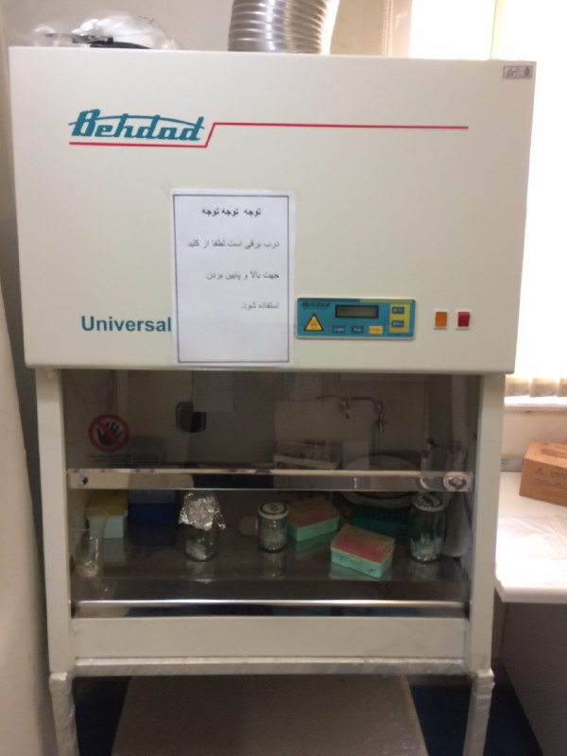
General Chemistry Fume Hood

Slide 15
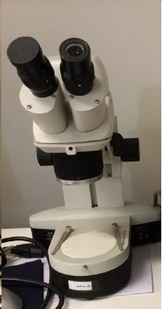
Microscope

Slide 16
Cell Research Lab
Dr. Zahra Gholamnejad

Slide 17
Behdad Chemistry Hood

